Slide 1
Digital Portfolio
STUDENT NAME: Nethra.S
REGISTER NO AND NMID: 222402623/asunm161222402623
DEPARTMENT: Computer Science With Data Science
COLLEGE: Prince Shri Venkateshwara Arts and Science collage/ Madras UNIVERSITY

Slide 2
PROJECT TITLE
Digital Portfolio

Slide 3
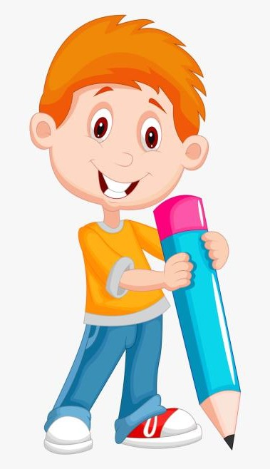

AGENDA
Problem Statement
Project Overview
End Users
Tools and Technologies
Portfolio design and Layout
Features and Functionality
Results and Screenshots
Conclusion
Github Link
3/21/2024 Annual Review

Slide 4

PROBLEM STATEMENT Freshers lack a strong personal brand in competitive markets.Without uniqueness, they blend in with thousands of applicants.Recruiters need to see personality and creativity too.A portfolio can showcase identity beyond academics. They prefer quick insights into strengths and achievements.A digital portfolio gives them a clear, interactive overview.

Slide 5

PROJECT OVERVIEW A visually appealing portfolio website that balances academics and creativity. It includes sections like About Me, Skills, Hobbies, Education, and Contact, with my profile image as a centerpiece to make it more personalized.

Slide 6

WHO ARE THE END USERS? Recruiters & Hiring Managers – to assess skills, projects, and experience. Clients – to evaluate work quality before giving projects. Teachers / Professors – for academic assessments or project reviews. Peers / Colleagues – for collaboration and feedback. Industry Experts / Mentors – to provide guidance and validation. General Audience – anyone interested in learning about your work, skills, or services.

Slide 7

TOOLS AND TECHNIQUES
Tools:
VS Code, GitHub, Canva (for visuals).
Technologies:
HTML5, CSS3, JavaScript, Tailwind CSS.
Google Fonts (Inter).

Slide 8
POTFOLIO DESIGN AND LAYOUT
Design Choices:
Gradient background (blue–purple theme).
Responsive, mobile-friendly design.
Minimal and professional typography (Inter).
Layout:
Sections: Home, About Me, Education, Contact.
Sticky header navigation.
Footer with email & copyright.
8

Slide 9
FEATURES AND FUNCTIONALITY
Interactive Features:
Hover effects (scale, shadow, color transitions).
Smooth navigation with sticky header.
Content Sections:
Hero (photo + intro).
About Me (skills & hobbies).
Education.
Contact (email).
Responsive Design: Works on desktop & mobile.

Slide 10
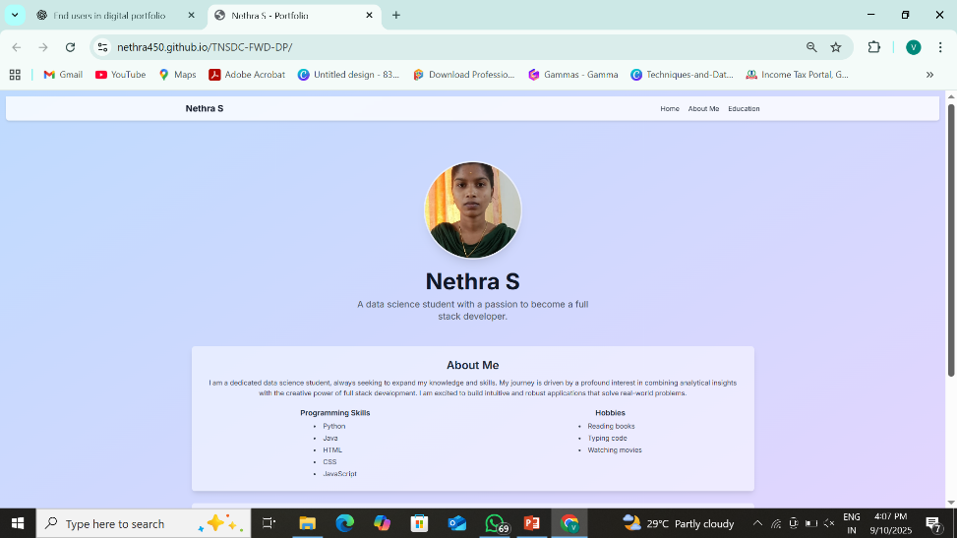
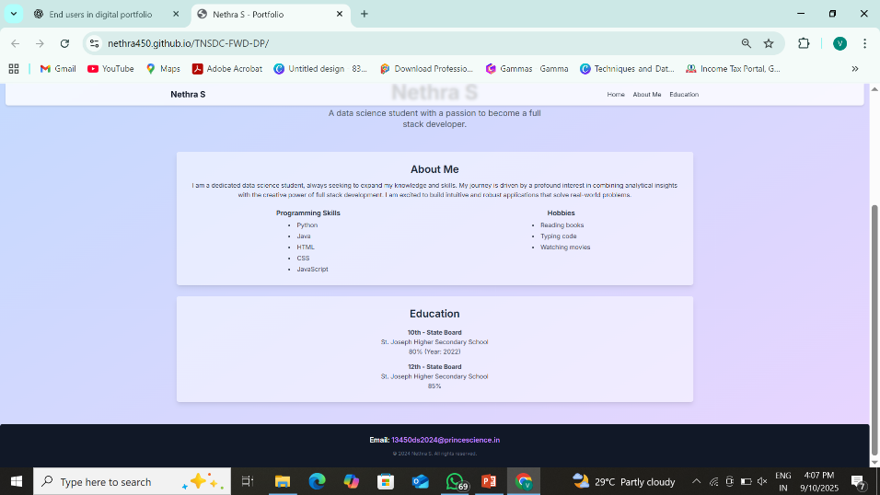

RESULTS AND SCREENSHOTS
Home page (hero image + intro).
About Me section (skills & hobbies).
Education section.
Footer (contact details).
3/21/2024 Annual Review
10

Slide 11
CONCLUSION
Successfully created a professional digital portfolio.
Easy to navigate, visually appealing, and responsive.
Helps showcase skills, projects, and education to recruiters and clients.
Future scope: Add projects section, blog, and downloadable resume.
https://nethra450.github.io/TNSDC-FWD-DP/
NM ID: 90907B0DA328F6C9B814190B6666CFF2
11

